Slide 1

Improve your JavaScript by 20% in 5 min

Slide 2
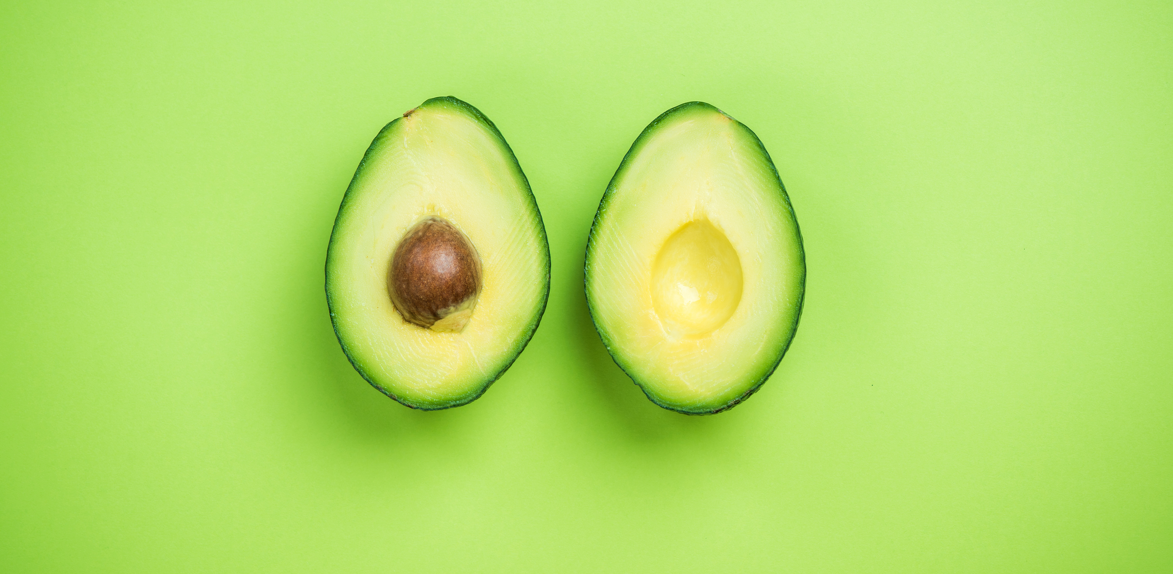

Slide 3

Hi
Robert
sadev.co.za
devconf.co.za
goodname.co.za

Slide 4
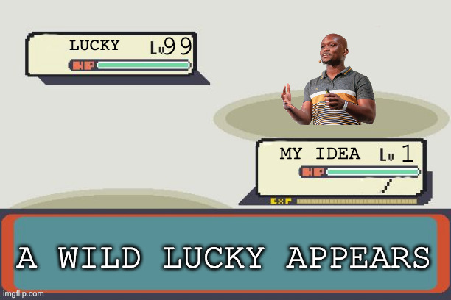
What to expect
But can it be longer….
1 simple trick that makes your JavaScript 20% faster*
5 – 10min lightning talk

Slide 5
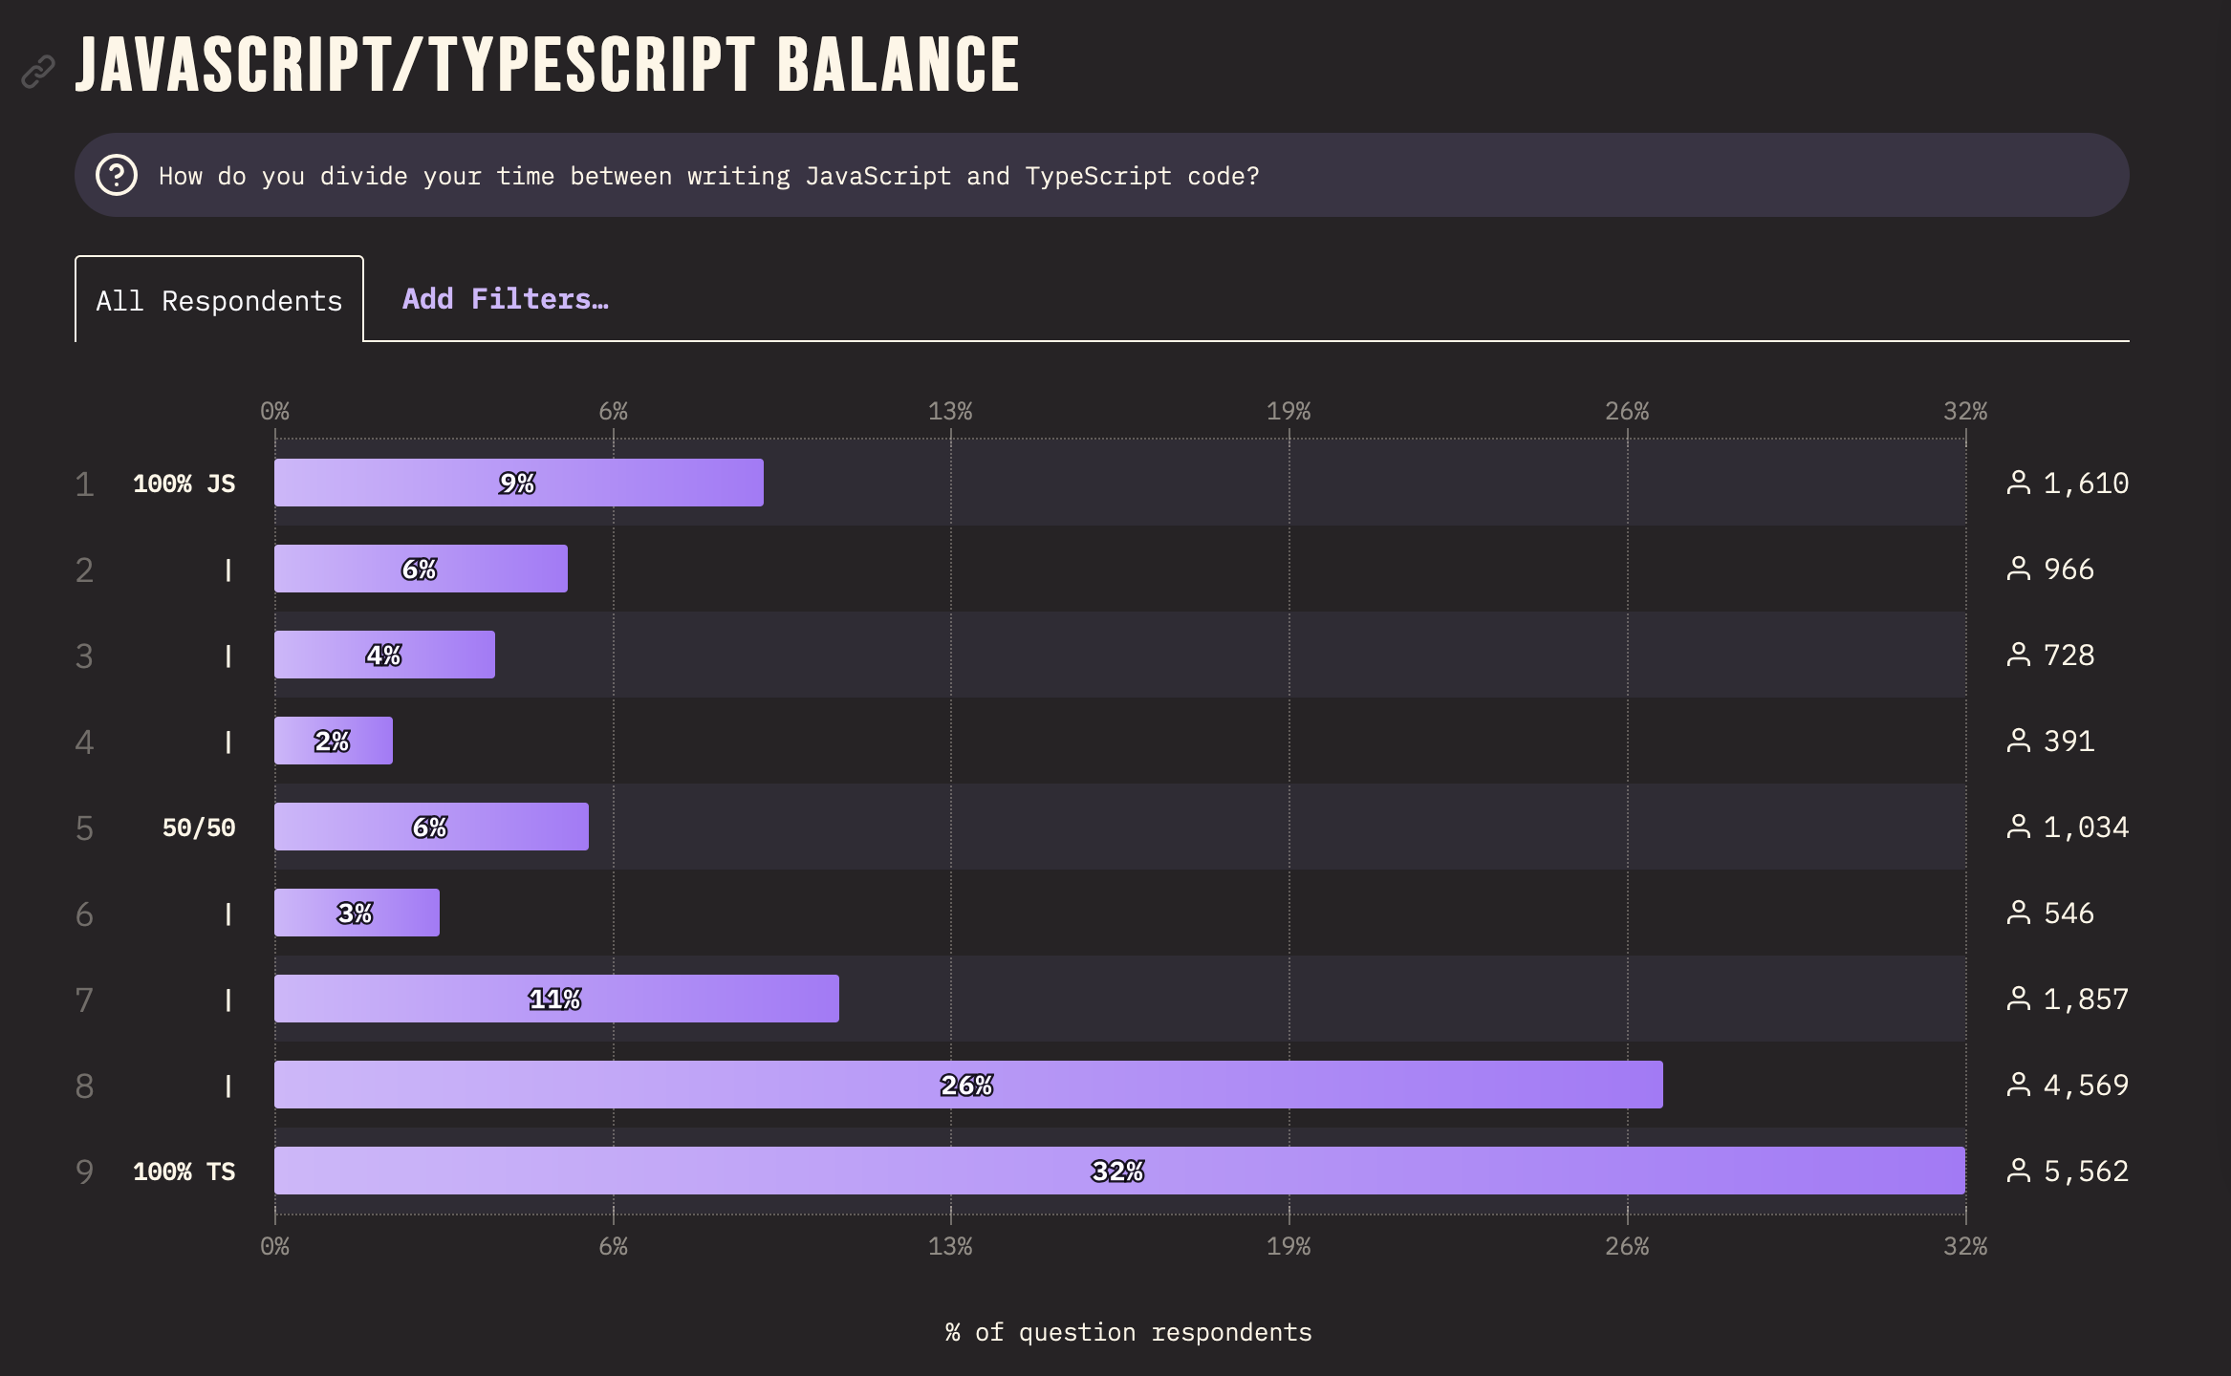
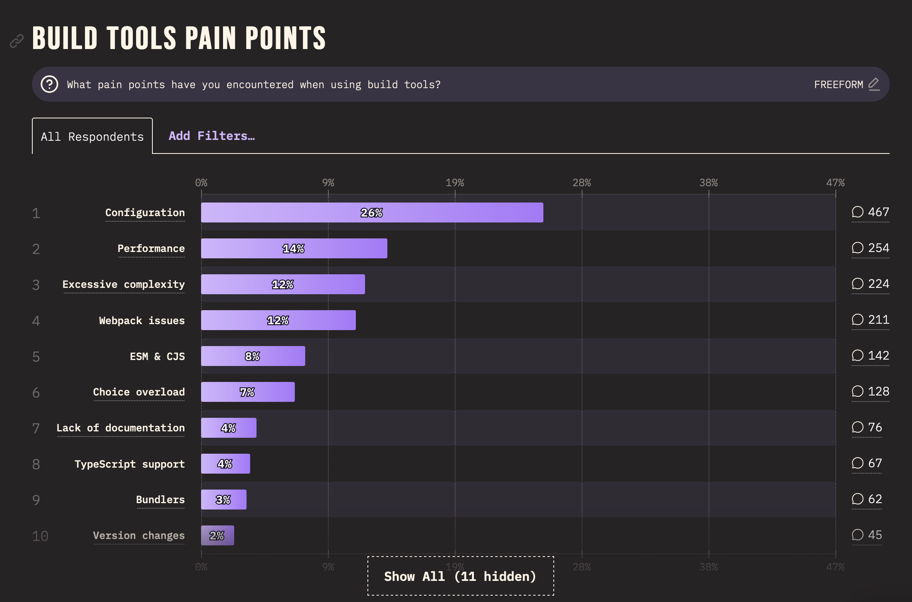
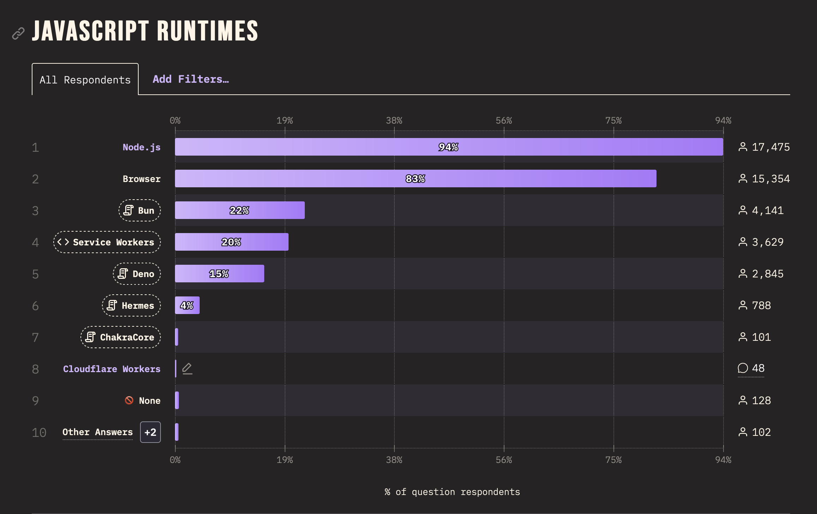
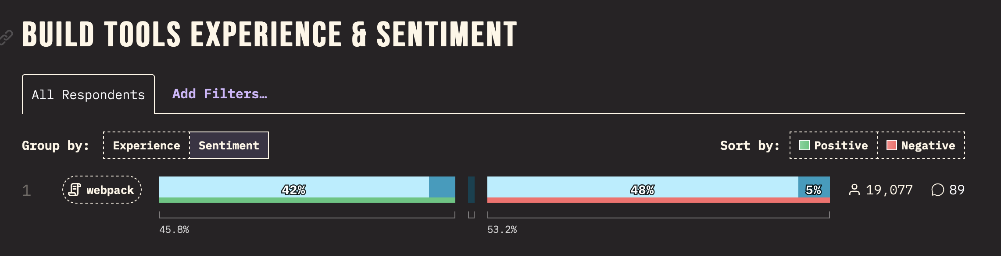
Pain points
SO LET US MAKE JAVASCRIPT DEVELOPMENT 20% BETTER TOGETHER

Slide 6

How do we code?
Step 1: git clone
Step 2: npm i
Step 3: vscode
Step 3.5: copilot how do I handle modules with TS?
Step 4: tsc index.ts
Step 5: node run index.js
Step 6: Profit!

Slide 7
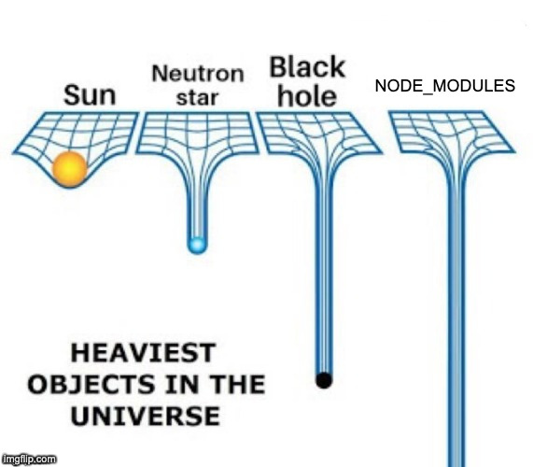
How do we code?
Step 1: git clone
Step 2: npm i
Step 3: vscode
Step 3.5: copilot how do I handle modules with TS?
Step 4: tsc index.ts
Step 5: node run index.js
Step 6: Profit!
Speed
Security
Dependency Resolution
Weird Config

Slide 8
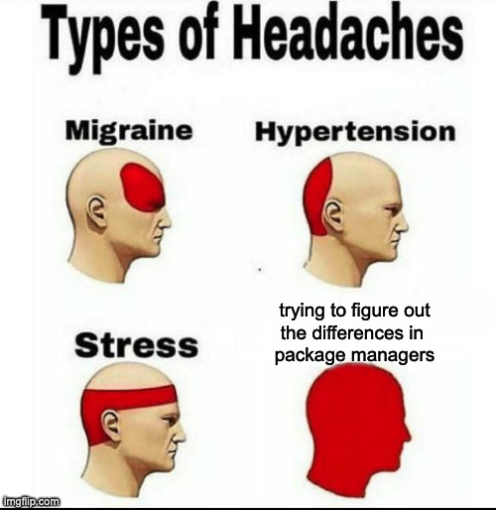
Other choices
yarn classic
yarn modern
yarn pnp
pnpm
bun

Slide 9


Slide 10
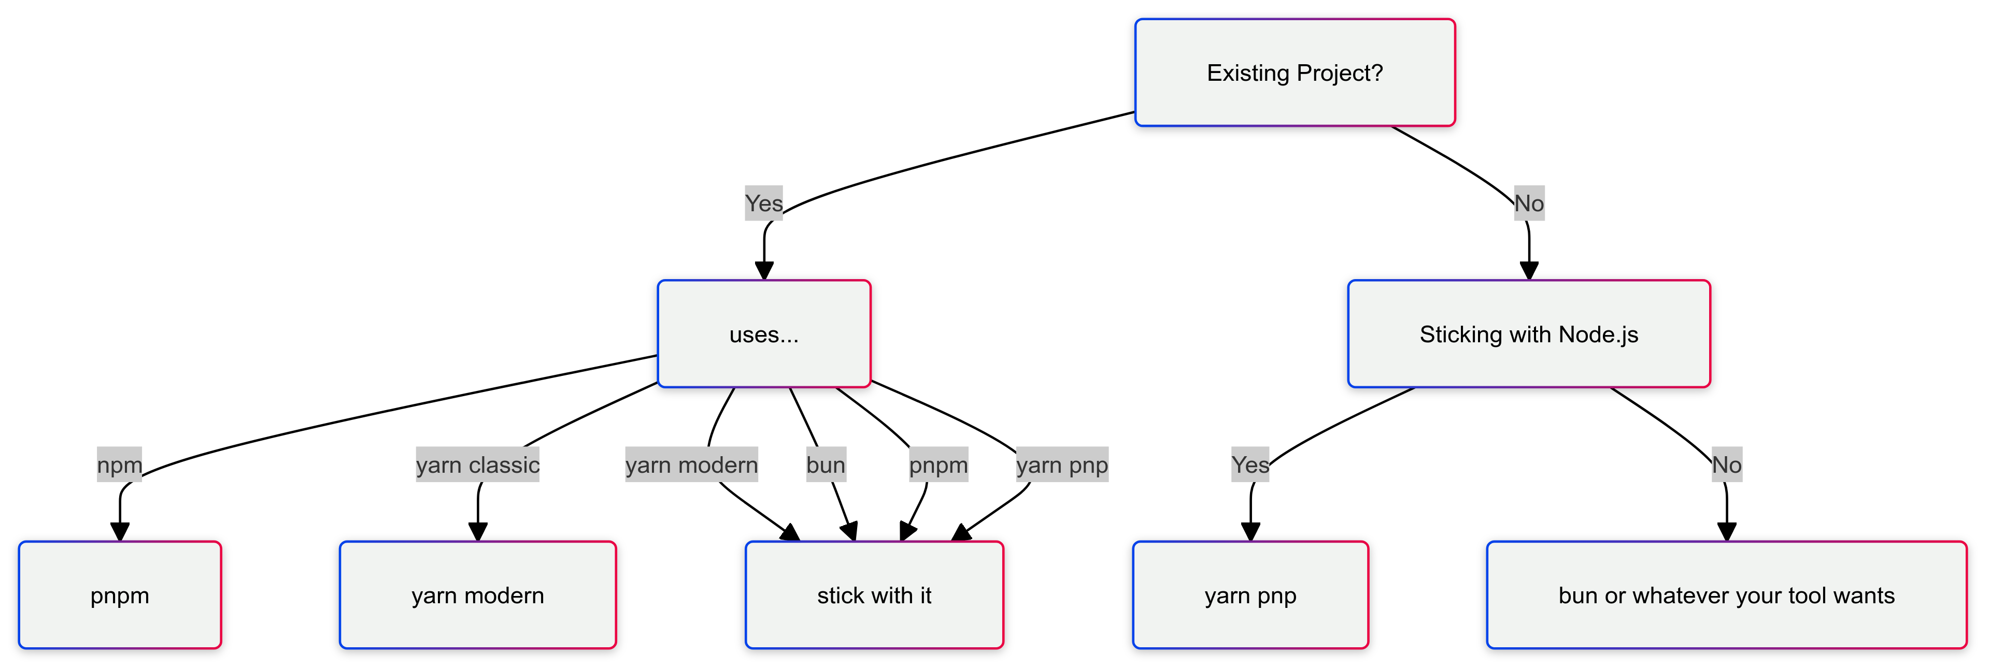
My approach

Slide 11

My approach

Slide 12
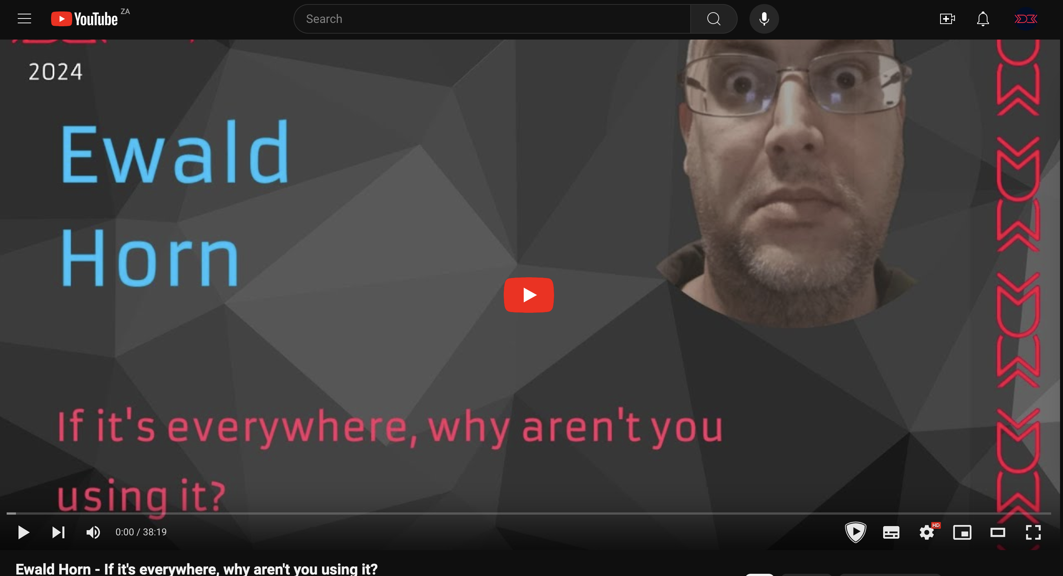
Not covering but possible
WebAssembly
JerryScript & QuickJS
LLRT
And SO MANY MORE SMALLER ONES
Notes:
JerryScript is iot – tiny
LLRT – is AWS, super fast start up

Slide 13


Slide 14

Bun
Node.js compat
Just works module support
JSX, TSX & TS first class
Bundler for the web
Jest compatible test runner
Built-in HTTP server w/ websockets, routing etc…
Notes:
Lots built in
http server w/ websockets

Slide 15
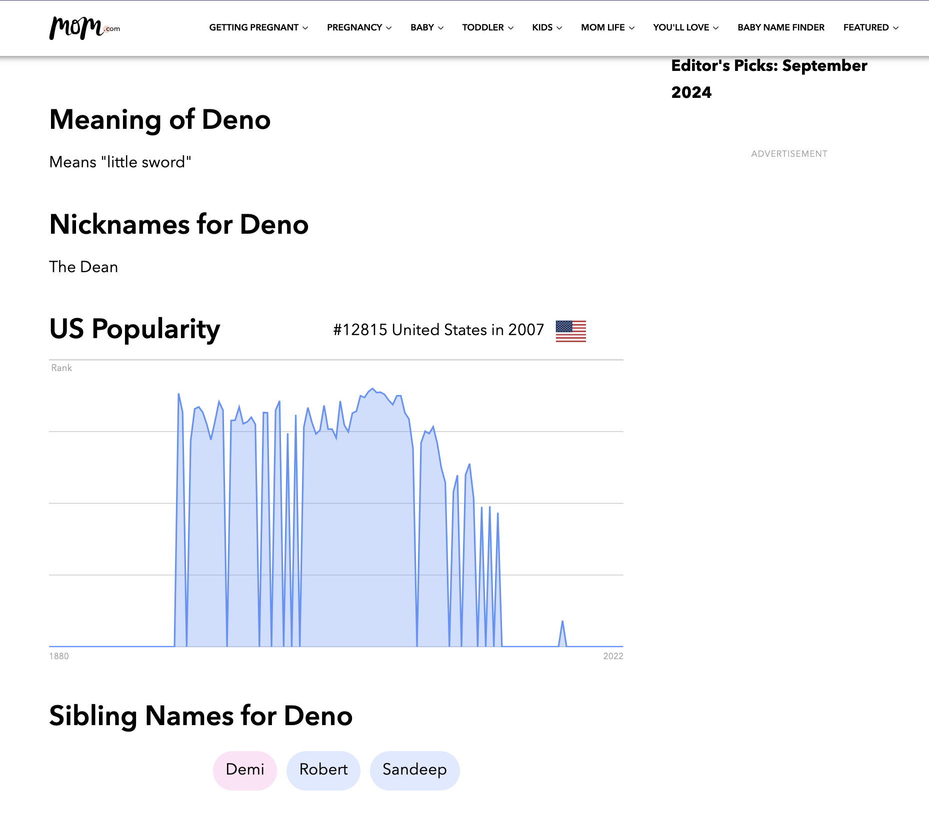

Slide 16

Deno
Node.js compat-ish
ES Modules
JSX, TSX & TS first class
Full tool ecosystem: benchmarks, executable compiler, tests, coverage, linter, formatter, and docs
Web Standard APIs
Secure by default
Built-in HTTP server w/ websockets, routing etc…

Slide 17
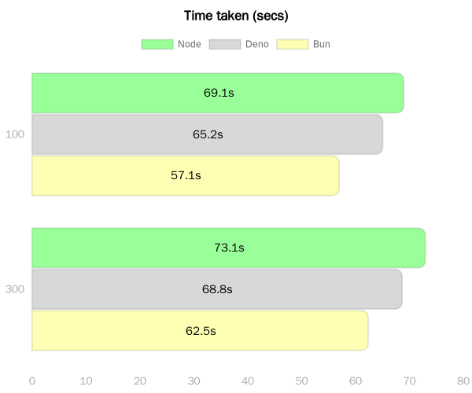
Performance
Bun
Deno
Node.js
https://bit.ly/3XbRq3E
Notes:
https://medium.com/deno-the-complete-reference/node-js-vs-deno-vs-bun-database-reads-performance-feb6e279c314

Slide 18

What did we see?
CHALLENGE YOUR THINKING!
MODERN JS IS FAST AND WONDERFUL
Different package managers
Different package repo
Different runtimes
Still the same language you love
Go back to the office, and change all your projects to the new hotness over the weekend?
Notes:
Lots built in
http server w/ websockets

Slide 19
How do we code?
Step 1: git clone
Step 2: CHALLENGE YOUR ASSUMPTIONS
Step 3: ADOPT A RESCUE DOG
Step 3.5: BOOP THE DOGS SNOOT
Step 4: DO NOT COMPARE YOUR BLOOPER REEL TO MY HIGHLIGHT REEL
(this will be really lame if my demos failed)
Step 5: THANK YOURSELF FOR HELPING MAKE JAVASCRIPT DEV 20% BETTER TODAY
Step 6: Profit! (cause it is still capitalism)

