Slide 1
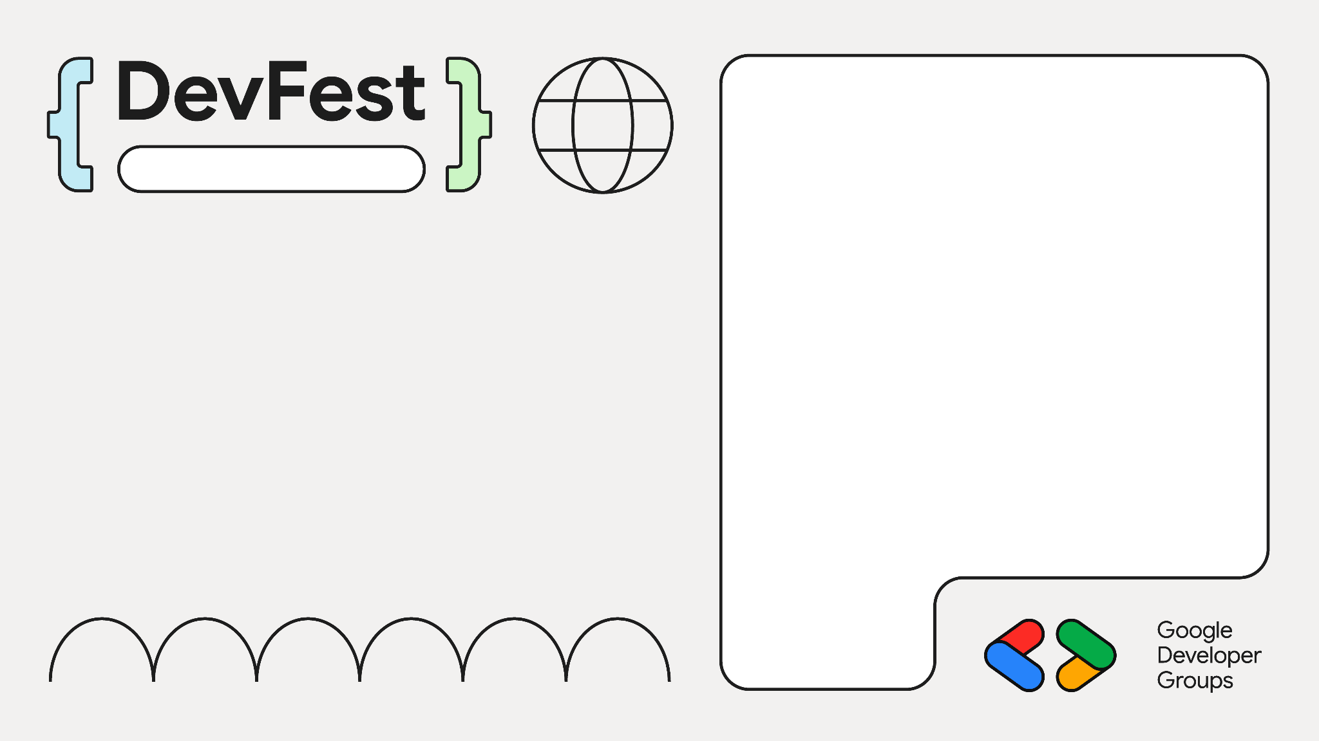

Improve your JavaScript by 20% in 5 minutes
Cape Town
Robert MacLean

Slide 2
Hi
Robert
@sadev.co.za
@devconf.co.za
@goodname.co.za

Slide 3

Call for speakers is open
Sponsor sales is open
Ticket sales are open

Slide 4
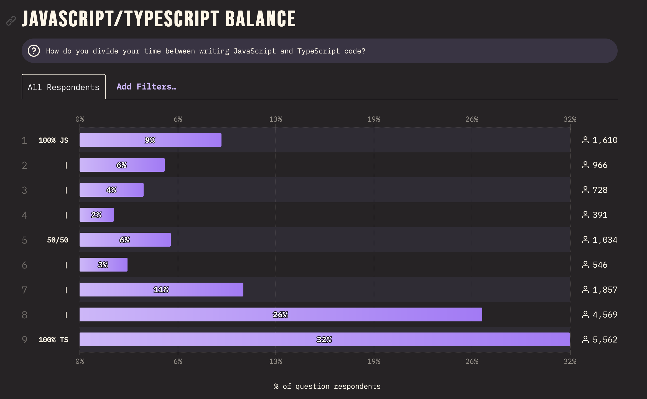
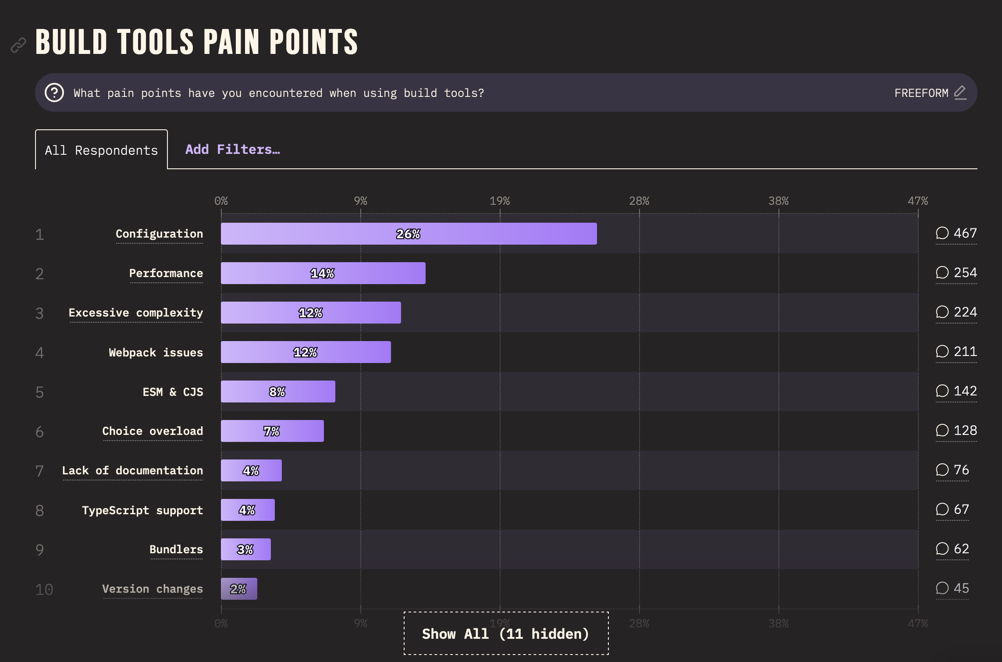
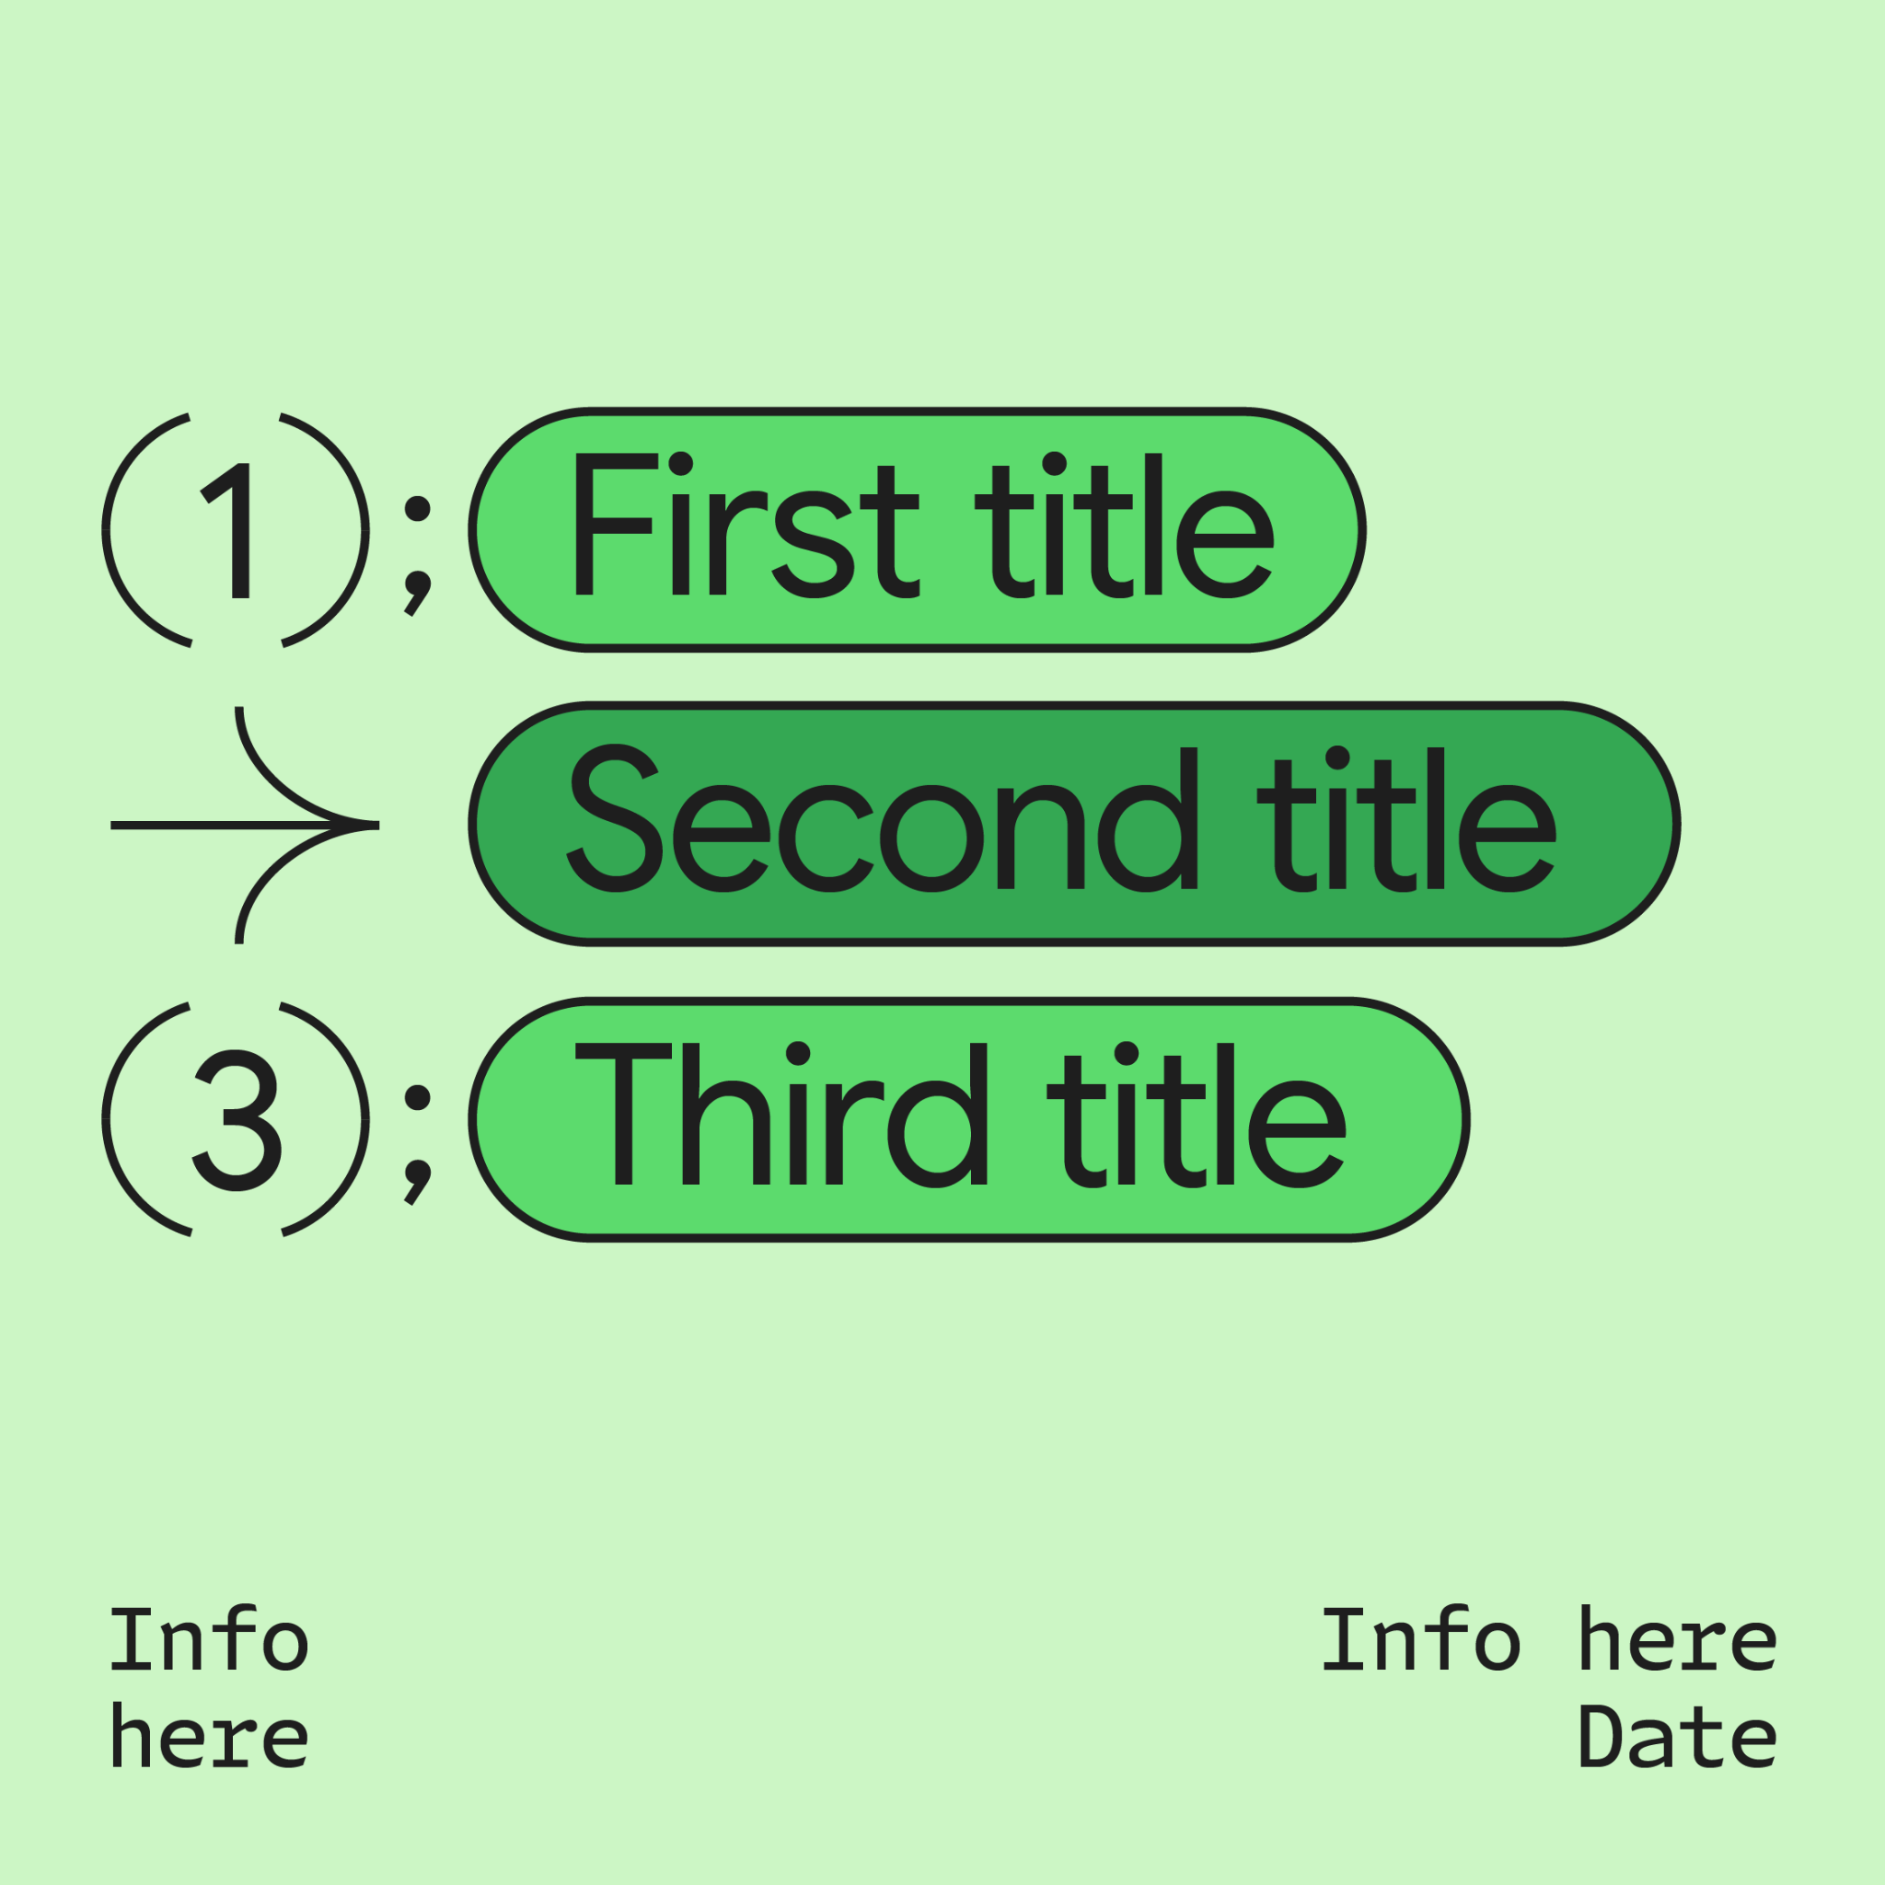
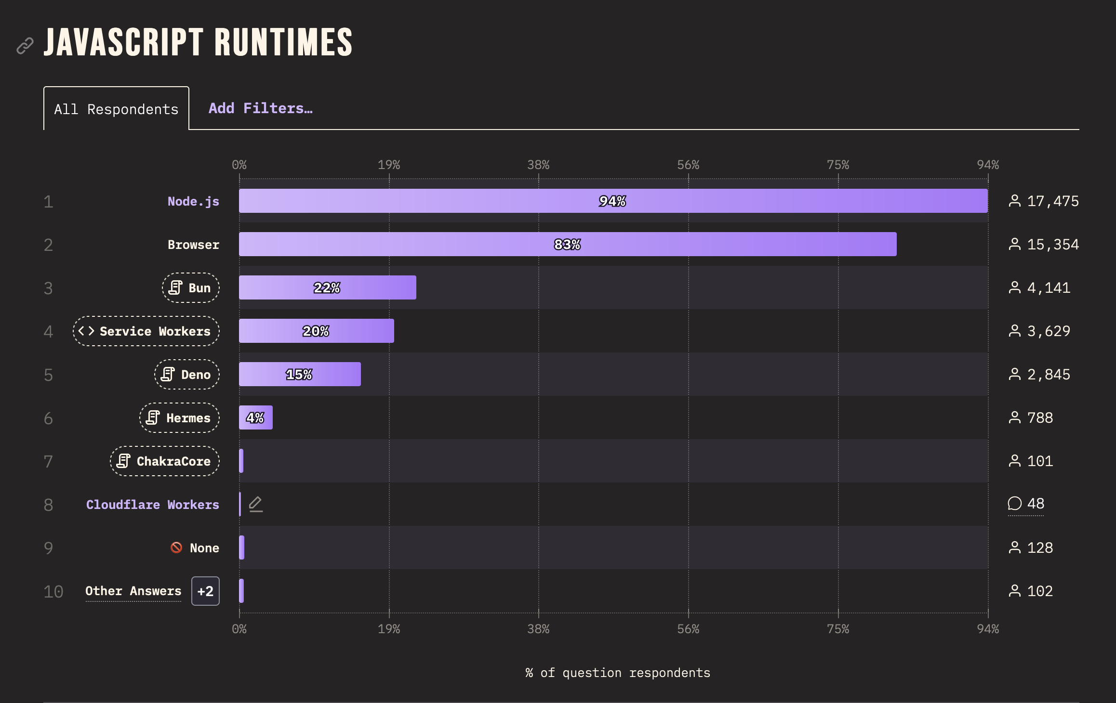
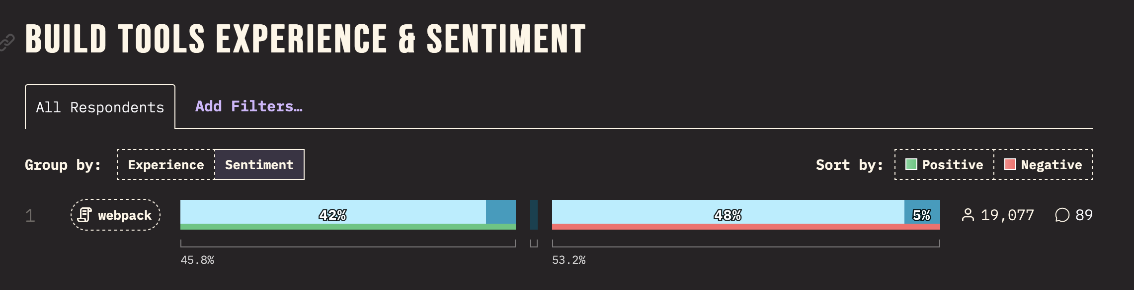
Pain Points
WE WILL MAKE JAVASCRIPT DEVELOPMENT 20% BETTER TOGETHER TODAY

Slide 5

How do we code?
1
git clone
2
npm i
3
vscode
3½
copilot, how do I handle modules with TypeScript?
4
tsc index.ts
5
node run index.js
6
PROFIT!

Slide 6
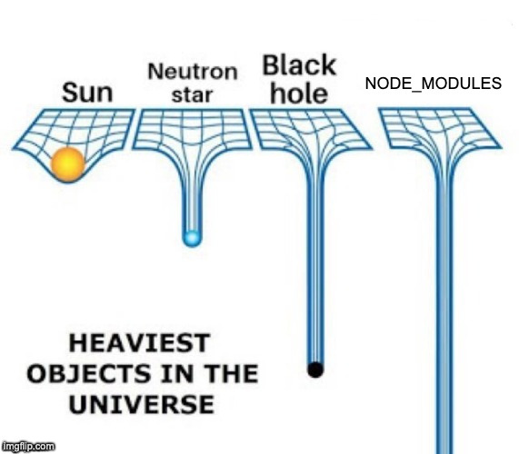
How do we code?
1
git clone
2
npm i
3
vscode
3½
copilot, how do I handle modules with TypeScript?
4
tsc index.ts
5
node run index.js
6
PROFIT!

Slide 7

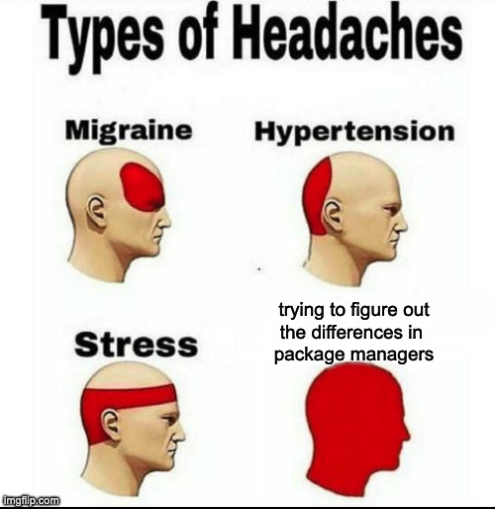




Other Choices
yarn classic
yarn modern
yarn pnp
pnpm
bun

Slide 8

Let’s Do Some Package Management

Slide 9
My Approach
Existing Project
Yes
No
Currently Use?
Stick with Node.js?
npm
yarn classic
yarn modern
Yes
No
pnpm
yarn modern
pnpm
pnpm
deno
yarn pnp
stick with it

Slide 10

My Approach
Stick with Node.js?
Existing Project
Yes
No
No
Currently Use?
???
npm
yarn classic
yarn modern
Yes
pnpm
yarn modern
pnpm
pnpm
yarn pnp
stick with it

Slide 11

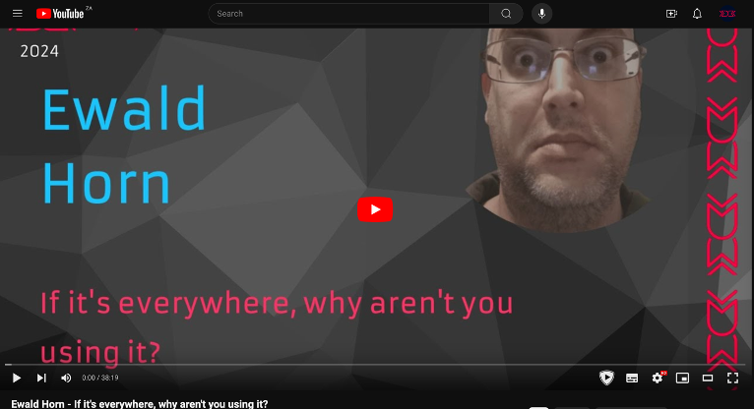
Other JS options are available
Deno
bun
WebAssembly
JerryScript & QuickJS
LLRT
Notes:
JerryScript is iot – tiny
LLRT – is AWS, super fast start up

Slide 12
Other options are available
Deno
bun
WebAssembly
JerryScript & QuickJS
LLRT
Notes:
JerryScript is iot – tiny
LLRT – is AWS, super fast start up

Slide 13
Let’s see bun

Slide 14
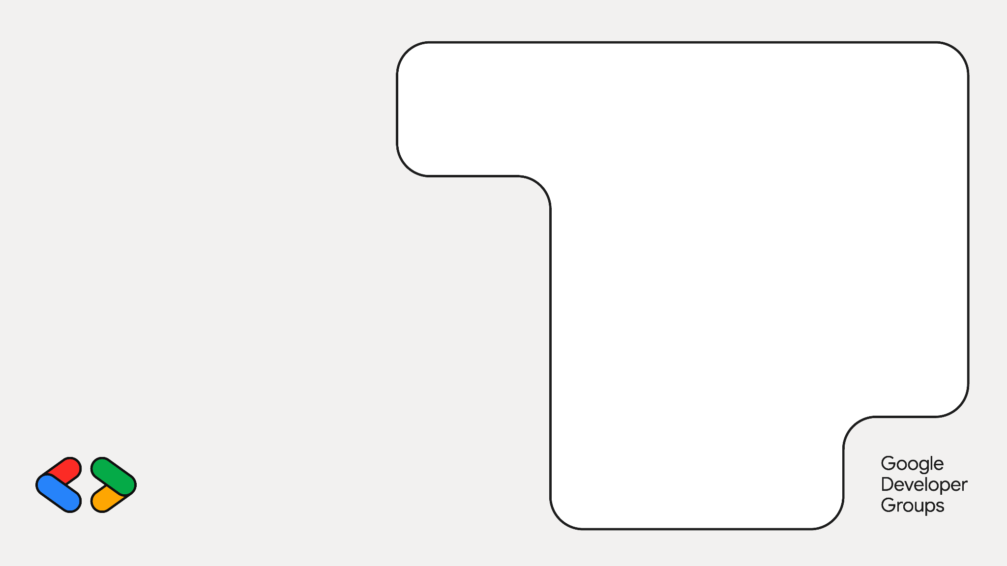

Bun Node.js compat
Just works module support
JSX, TSX & TS first class
Bundler for the web
Jest compatible test runner
Built-in HTTP server w/ websockets, routing etc…

Slide 15
Let’s see Deno

Slide 16

Deno Node.js compatible ES Modules JSX, TSX & TS first class Full tool ecosystem: benchmarks, executable compiler, tests, coverage, linter, formatter, and docs Web Standard APIs Secure by default Built-in HTTP server w/ WebSocket's, routing etc…

Slide 17
Performance
69.1 sec
100
65.2 sec
57.1 sec
73.1 sec
300
68.8 se
Node.js
62.5 sec
Deno 1
bun
https://bit.ly/3XbRq3E

Slide 18
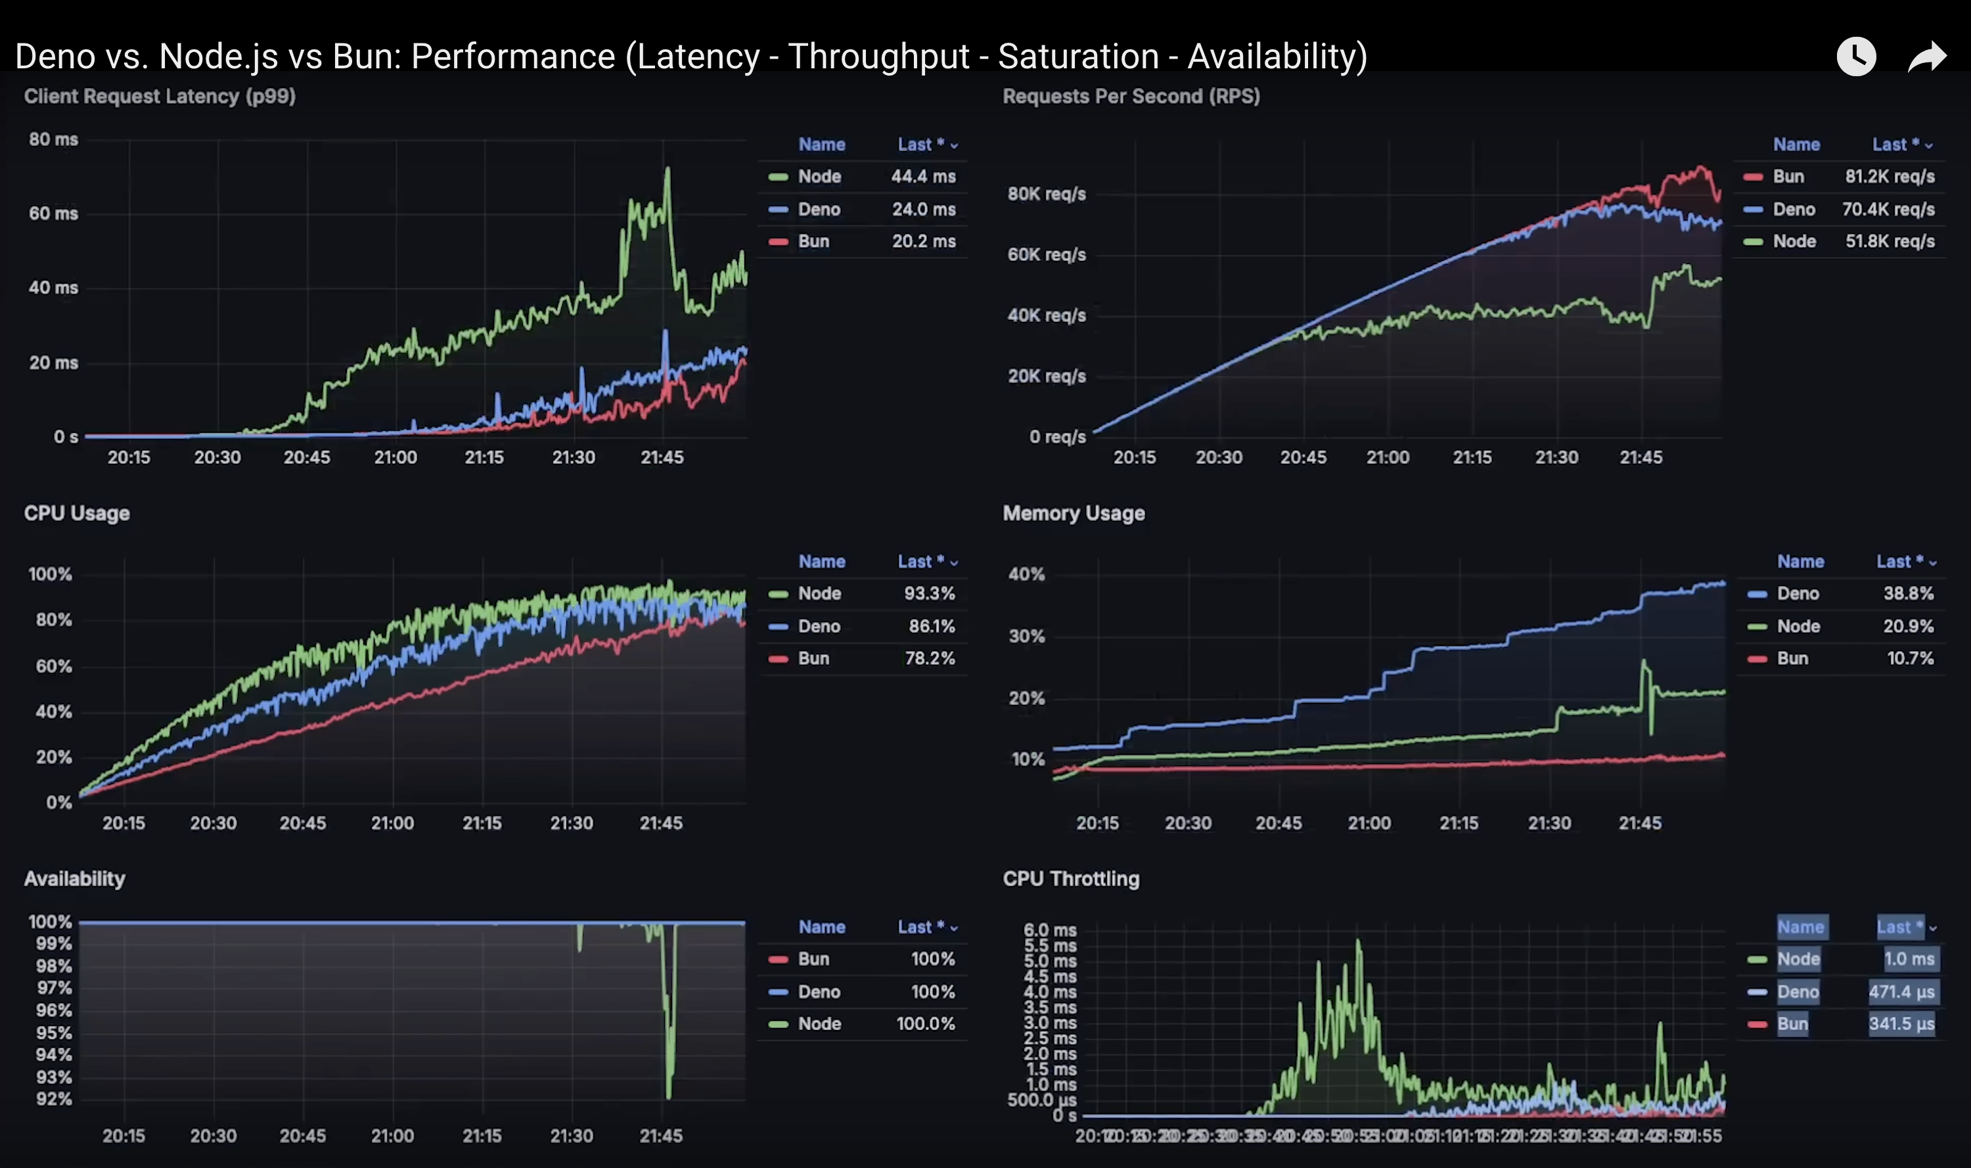
Performance
https://www.youtube.com/watch?v=yJmyYosyDDM&t=617s
Notes:
Anton Putra

Slide 19
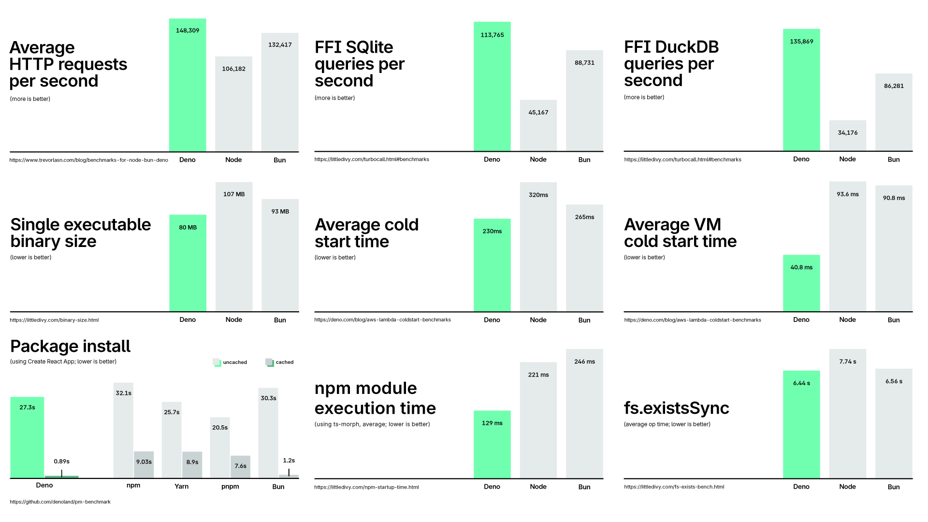
Performance

Slide 20
What did we see today?
Cool New Tech
Yarn
pnpm
bun
Deno
JSR
Still the same language you love
Hopefully this challenges your thinking and inspires exploring…
Modern JavaScript is FASTER, EASIER and MORE WONDERFUL than ever before

Slide 21
How do we NOW code?
1
git clone
2
CHALLENGE YOUR ASSUMPTIONS
3
ADOPT A RESCUE DOG
3½
BOOP THE SNOOT
4
DO NOT COMPARE YOUR BLOOPER REEL TO OTHERS HIGHLIGHT REEL
5
THANK YOURSELF FOR HELPING MAKE JAVASCRIPT 20% BETTER TODAY
6
PROFIT! (cause it is still a capitalist world)

Slide 22

Cape Town
Thank you

